Slide 1

Data Vis 1
Top Movie Posters and IMDb
By: Jason Barnes

Slide 2
The Story

Slide 3
Data
IMDb Datasets (https://www.imdb.com/interfaces/)
4 datasets (ratings, basics, principals and name basics)
.TSV - largest file has over 6.9 million observations (basics) mix of all types (videogame, movie, short film, TV series etc.)
Free to public
Movie Poster Shop (https://www.moviepostershop.com/feature/mini/100-best-selling-movie-posters/default.asp?page=1#results)
Paginated data over 6 pages
Web crawl the data using methods I published in one of our discussions

Slide 4
Data issues
Film Titles
Star Wars retroactively titled Star Wars: Episode IV - A New Hope
Kill Bill: Vol 1 vs Kill Bill Vol 1
Star Trek 2 vs Star Trek II
Original titles vs Primary Titles ( Spirted Away - Sen to Chihiro no kamikakushi (original title)
Godfather, Part 2 vs The Godfather: Part II
Band of Brothers - Not a film (HBO Miniseries)
Approx. 25 films total had to be cleaned to match

Slide 5
Tools and Methods
Tools
R (R Studio)
Adobe XD
Illustrator
PowerPoint
Methods
Connected the IMDB datasets via left join on a primary key provided in each dataset except name basics
Connected new dataset called df_rating_basics to the web crawled data based on film title
Output the data to csv where I had to clean the data that was not properly joined
Brought clean Top 100 posters with IMDb Data back into R to begin visualization process

Slide 6
Ideas and Presentation

Slide 7





Ideas and Presentation

Slide 8
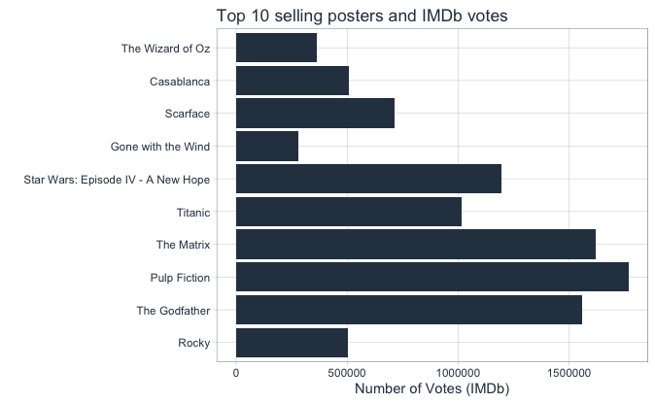
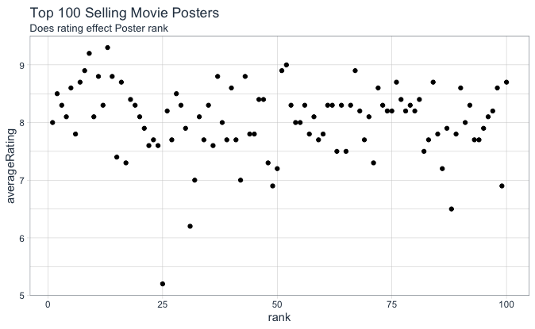
Ideas and Presentation

Slide 9
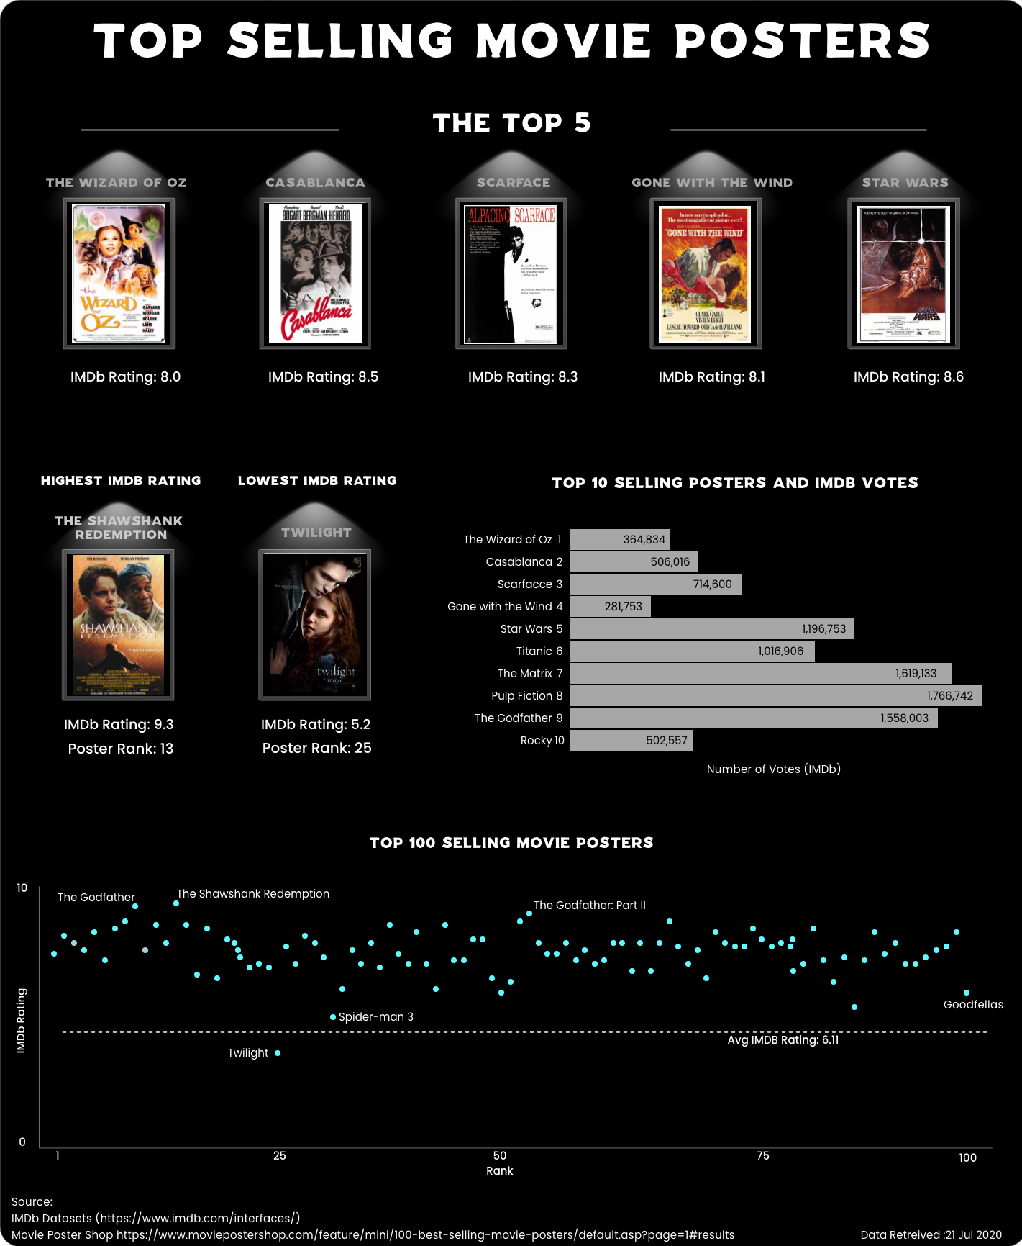

Slide 10
Questions
Visualization can be found here: https://xd.adobe.com/view/f7d2919c-4931-4449-96f2-eaba49a27c5f-a281/?fullscreen

